Slide 1
DNS
Domain Name System

Slide 2
Domain Name System
Domain Name System (or Service or Server), an Internet service that translates domain names into IP addresses. Because domain names are alphabetic, they are easier to remember. The Internet is based on IP addresses. Every time you use a domain name, therefore, a DNS service must translate the name into the corresponding IP address.
For example:
The domain name www.example.com might translate to 198.105.232.4

Slide 3
Features of DNS
DNS Server has its own network. If one DNS server doesn't know how to translate a particular domain name, it asks another one, and so on, until the correct IP address is returned.
purpose of DNS is to translate domain names into IP addresses
DNS services can used in public Network (Internet) and as well as Private Network.
Now a days, we can’t even imagine a Internet without DNS.

Slide 4
DNS Structure
DNS used hierarchical or inverse Tree Structure
DNS is a Distributed System.

Slide 5
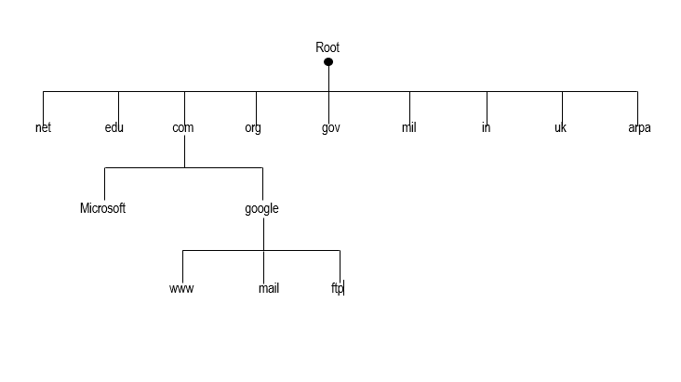
DNS Structure

Slide 6
Domain Name System
Domain name space (tree) is divided into three different sections:
Generic domains
Country domains
Inverse domains

Slide 7
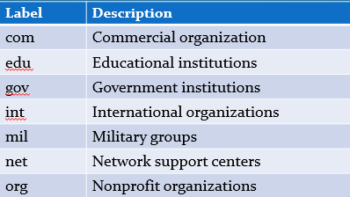
Generic Domains
A generic top-level domain (gTLD) is a top-level domain (TLD) category that is easily recognized by a suffix attached to a domain name. These are used by the Internet’s Domain Name System (DNS), with oversight by the Internet Assigned Numbers Authority (IANA), which is now controlled by the Internet Corporation for Assigned Names and Numbers (ICANN).
define registered hosts according to their generic behavior (3 char):

Slide 8
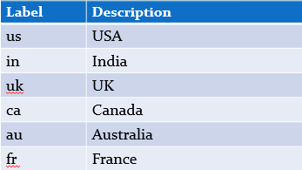
Country Domains
A country code top-level domain (ccTLD) is an Internet top-level domain generally used or reserved for a country, sovereign state, or dependent territory identified with a country code. All ASCII ccTLD identifiers are two letters long, and all two-letter top-level domains are ccTLDs.
2 character country abbreviations:

Slide 9
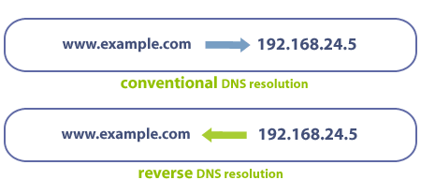
Inverse Domains
The inverse domain finds a domain name for a given IP address. This is called address-to-name resolution.

Slide 10
Resolving Names to Addresses
HOSTS.txt was used earlier (managed by Stanford Research Institute International (SRI)
In 1983, Paul Mockapetris introduce the concept of DNS
The root of DNS database on the Internet is managed by the Internet’s Network Information Center (InterNIC).
The top-level domains were assigned organization wise, and by country.

